Slide 1

Social Media
Sentiment Analysis
Using Twitter Dataset
Sentient Scribes
Pearl (Team Leader) 2210990648
Prachi Anand 2210990660
Prachi Malik 2210990661

Slide 2
Index
Introduction
Background
Motivation
Models Used
Libraries Used
API used
Results
Applications
Future Scope
Conclusion
References

Slide 3
Introduction
Welcome to our project on social media sentiment analysis, where we explore the depths of online interactions to uncover underlying emotions and opinions. In today's digital age, understanding social media sentiment is crucial for businesses, policymakers, and researchers alike. Leveraging advanced natural language processing techniques, we analyze text data to classify sentiment and contextualize it within socio-cultural dynamics. Our goal is to unveil insights that drive informed decision-making, enhance customer engagement, and deepen societal understanding. Explore with us as we delve into the transformative potential of sentiment analysis across various industries and disciplines, aiming to foster a more empathetic and connected society in the digital era.

Slide 4
Background
Social media, like Twitter, has changed how we talk and share online. There are billions of people using these platforms every day, which means there's a lot of information being shared. However, understanding what people are feeling or thinking in all those posts and comments can be tricky.
That's where social media sentiment analysis comes in. It's like a tool that helps us figure out how people are feeling based on what they say online. Using fancy technology, it looks at the words people use and tries to understand if they're happy, sad, or something else.
Our project is all about diving into this world of online feelings. We want to find out what people are talking about and how they're feeling about it. By doing this, we hope to learn things that can help businesses and other groups make better decisions. It's like peeking into the mood of the internet to see what's going on and why.

Slide 5
Motivation
Digital Influence: Social media shapes opinions and drives trends, making understanding sentiment crucial.
Untapped Insights: Vast amounts of social media data contain valuable, yet undiscovered insights.
Actionable Intelligence: Analyzing sentiment provides actionable insights for decision-making.
Real-World Impact: Our project aims to bridge digital discourse with real-world implications.
Empowering Decision-Making: By deciphering emotions and opinions, we empower stakeholders across industries.
Transformative Potential: Social media sentiment analysis has the power to drive meaningful impact.
Embracing Challenges: We're motivated to tackle the challenges of the digital age and leverage data-driven insights.
Creating a Brighter Future: Together, let's harness the power of sentiment analysis to shape a brighter future for all.

Slide 6
Models used: VADER
Valence Aware Dictionary and Sentiment Reasoner
VADER is a lexicon and rule-based sentiment analysis tool specifically designed for social media text.
It utilizes a pre-defined list of lexical features (words and phrases) with associated sentiment scores to analyze the sentiment of a given text.
VADER considers punctuation, capitalization, degree modifiers, and negations to accurately assess sentiment intensity.
It provides sentiment scores for positivity, negativity, and neutrality, as well as an overall compound score, making it useful for both sentiment classification and intensity analysis.
VADER is known for its simplicity, speed, and effectiveness in handling noisy and informal text data typical of social media platforms.

Slide 7
Models used: RoBERTa
Robustly optimized BERT approach
It is a state-of-the-art natural language processing model based on the transformer architecture, similar to BERT (Bidirectional Encoder Representations from Transformers).
It builds upon BERT's architecture and training methodology with several key enhancements, including larger batch sizes, longer training sequences, and dynamically masked language model training.
It achieves superior performance across various NLP tasks by leveraging large-scale datasets and advanced training techniques.
It is pre-trained on vast amounts of text data and fine-tuned on specific downstream tasks, allowing for efficient transfer learning and adaptation to diverse domains.
Its robustness, scalability, and versatility make it a popular choice of natural language processing applications, particularly those requiring high performance and accuracy.

Slide 8
Libraries Used:
Pandas
Pandas serve as a foundational tool for managing and analyzing social media data. We utilize Pandas DataFrames to organize and clean the data, apply transformations, and compute summary statistics. Its intuitive interface and powerful functionalities enable efficient data preprocessing, facilitating subsequent sentiment analysis tasks. Pandas flexibility allows us to seamlessly integrate various data sources and perform insightful analyses, contributing to the project's success.
Numpy
NumPy is integral for efficient numerical computation and array manipulation. We utilize NumPy arrays to store and manipulate numerical data extracted from social media sources. Its fast and optimized operations enable us to perform computations such as statistical analysis, numerical transformations, and array operations effectively. NumPy's seamless integration with other libraries like Pandas ensures smooth data processing and analysis pipelines, enhancing the project's overall efficiency and effectiveness.

Slide 9
Libraries Used:
Seaborn
Seaborn is a Python data visualization library based on Matplotlib. In our project, Seaborn is utilized to create insightful visualizations of sentiment analysis results and trends extracted from social media data. Its high-level interface simplifies the creation of various statistical plots, including bar plots, scatter plots, and heatmaps, enabling us to effectively communicate key findings and patterns derived from our analysis to stakeholders and decision-makers.
Matplotlib
Matplotlib is a Python library used for creating static, interactive, and publication-quality visualizations. In our project, we utilize Matplotlib to visualize various aspects of our sentiment analysis results, such as sentiment distribution across different social media platforms, temporal trends in sentiment, and comparative analysis between different topics or user demographics. Matplotlib's intuitive interface and extensive customization options enable us to effectively communicate insights derived from our data analysis.

Slide 10
Libraries Used:
Collections
The `collections` library in Python provides specialized container data types beyond the built-in ones like lists and dictionaries. In our project, we leverage `collections. Counter` to efficiently count the occurrences of sentiment labels or specific words/phrases in social media text. This helps us analyze sentiment distribution and identify key themes or topics within the data, enhancing the depth of our insights and facilitating data-driven decision-making.
Plotly
Plotly is a Python library used for creating interactive visualizations. In our project, Plotly is employed to visualize sentiment trends, word frequencies, and topic clusters extracted from social media data. By leveraging Plotly's rich array of visualization tools, we can effectively communicate insights to stakeholders, allowing for intuitive exploration of sentiment dynamics and facilitating data-driven decision-making.

Slide 11
Libraries Used:
NLTK(Natural Language Toolkit)
NLTK (Natural Language Toolkit) is a Python library widely used for natural language processing tasks. In our project, NLTK plays a crucial role in text preprocessing, tokenization, and sentiment analysis. We utilize its functions for tasks such as removing stopwords, stemming, and lemmatization to clean and prepare text data for analysis. Additionally, NLTK's sentiment analysis module provides tools for classifying the sentiment of social media posts, enhancing our understanding of user opinions and emotions.

Slide 12
API Used:
Tweepy API
Tweepy is a Python library for accessing the Twitter API. It simplifies the process of interacting with Twitter's platform, allowing users to programmatically retrieve, post, and manipulate Twitter data. In our project, we utilize Tweepy to collect social media data directly from Twitter. This includes fetching tweets, user profiles, and associated metadata relevant to our sentiment analysis task. By leveraging Tweepy's functionalities, we can efficiently gather real-time or historical data from Twitter, enabling us to analyze current trends, monitor public sentiment on specific topics, and conduct comprehensive sentiment analysis studies. Tweepy streamlines the data collection process, providing a seamless interface to access Twitter's vast repository of publicly available data, which serves as a valuable resource for our sentiment analysis project.

Slide 13
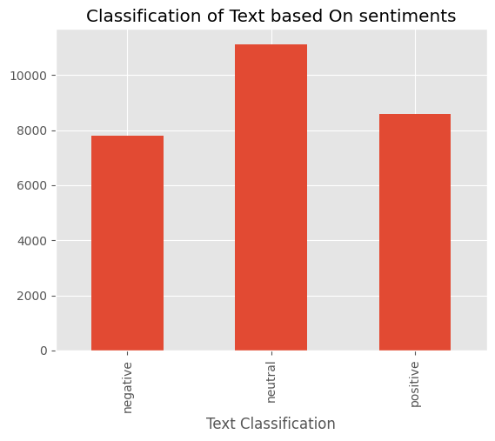
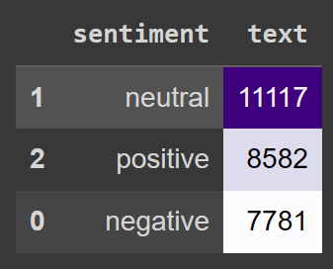
Results:
1. Classification of sentiment column in decreasing order
2. Graphical representation of sentiment column

Slide 14
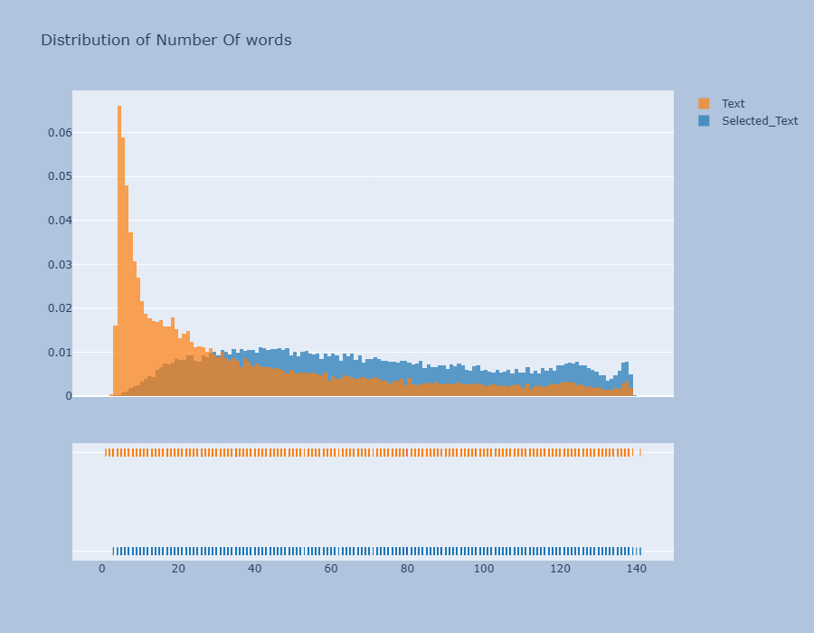
Results: 3. Distribution Of ‘Selected_text’ Column Using Plotly

Slide 15
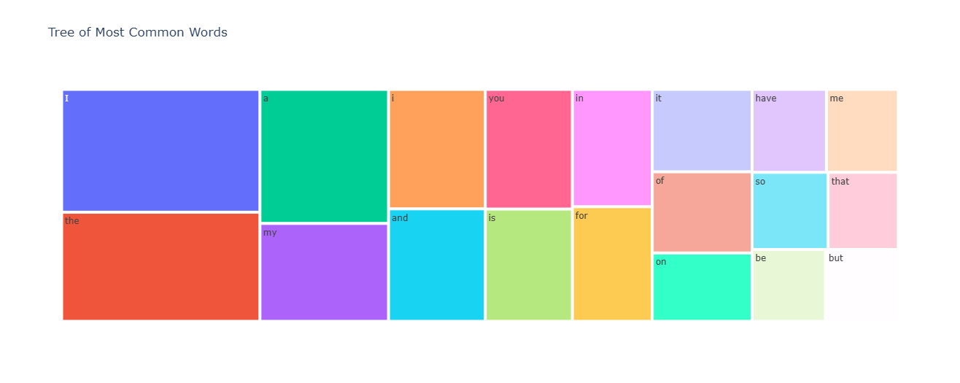
Results: 4. A Treemap Of Common Words Is Made Using Express Module Of Plotly Library.

Slide 16
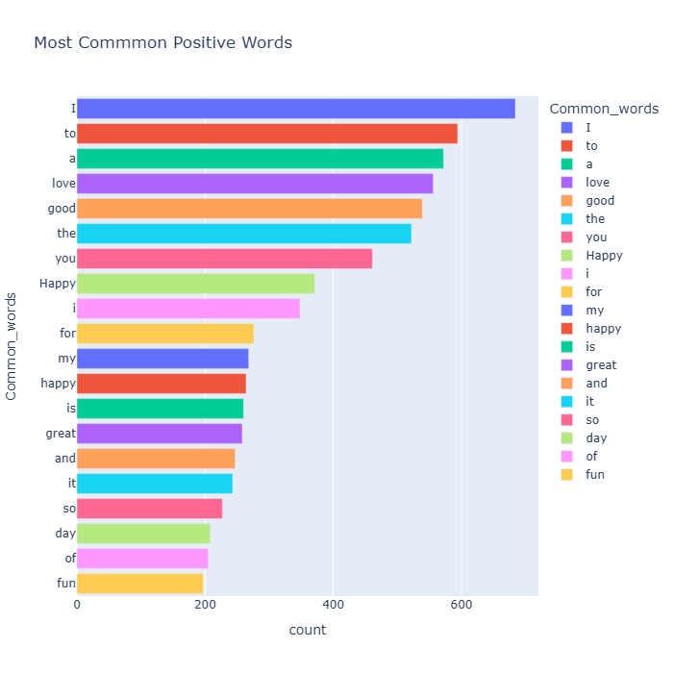
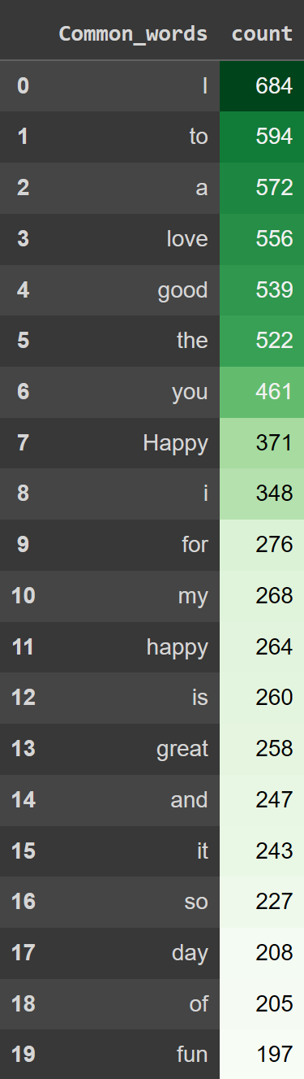
Results:
5. Bar representation of common positive words using express module of plotly

Slide 17
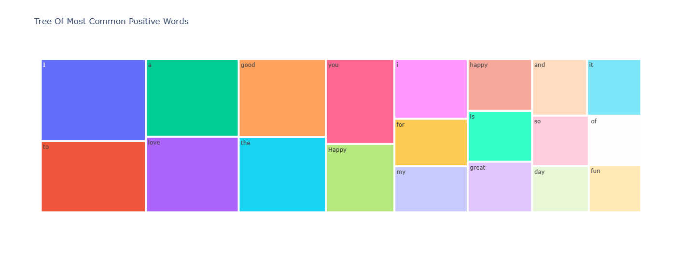
Results: 6. A Treemap Of Most Common Positive Words Is Made Using Express Module Of Plotly Library.

Slide 18
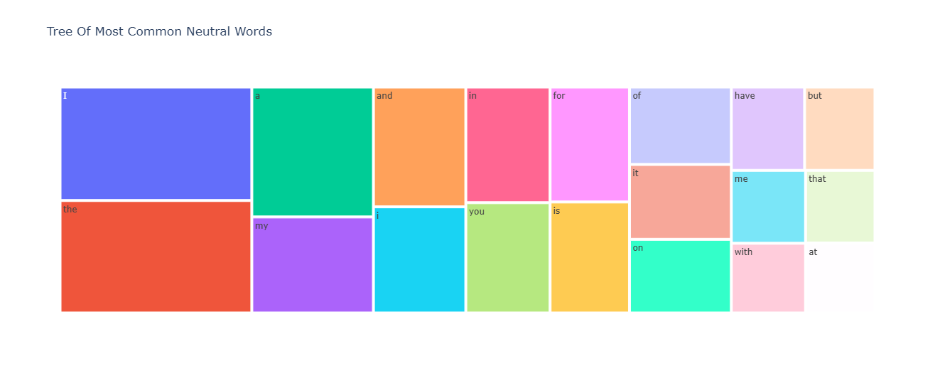
Results: 7. A Treemap Of Most Common Neutral Words Is Made Using Express Module Of Plotly Library.

Slide 19
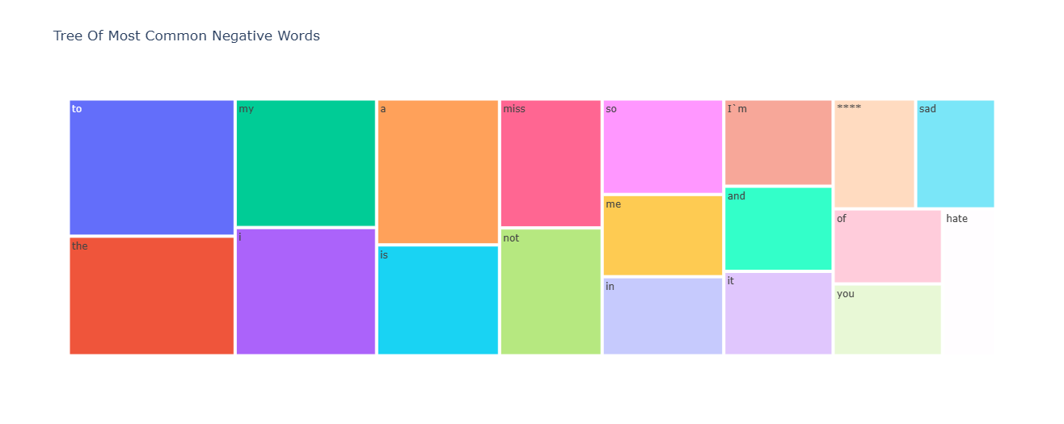
Results: 8. A Treemap Of Most Common Negative Words Is Made Using Express Module Of Plotly Library.

Slide 20
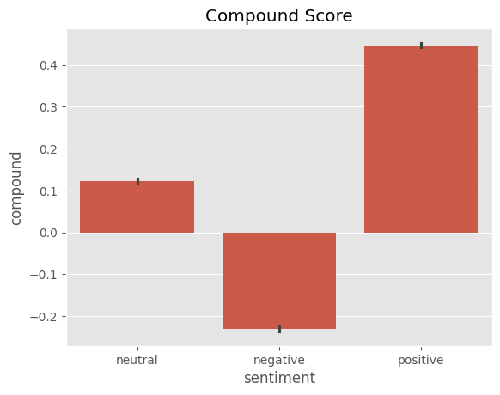
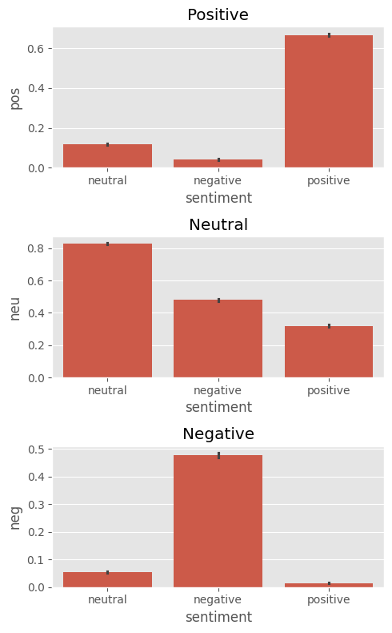
Results:
8. Vader Results Of Compound Score
9. VADER results of positive, neutral and negative columns.

Slide 21
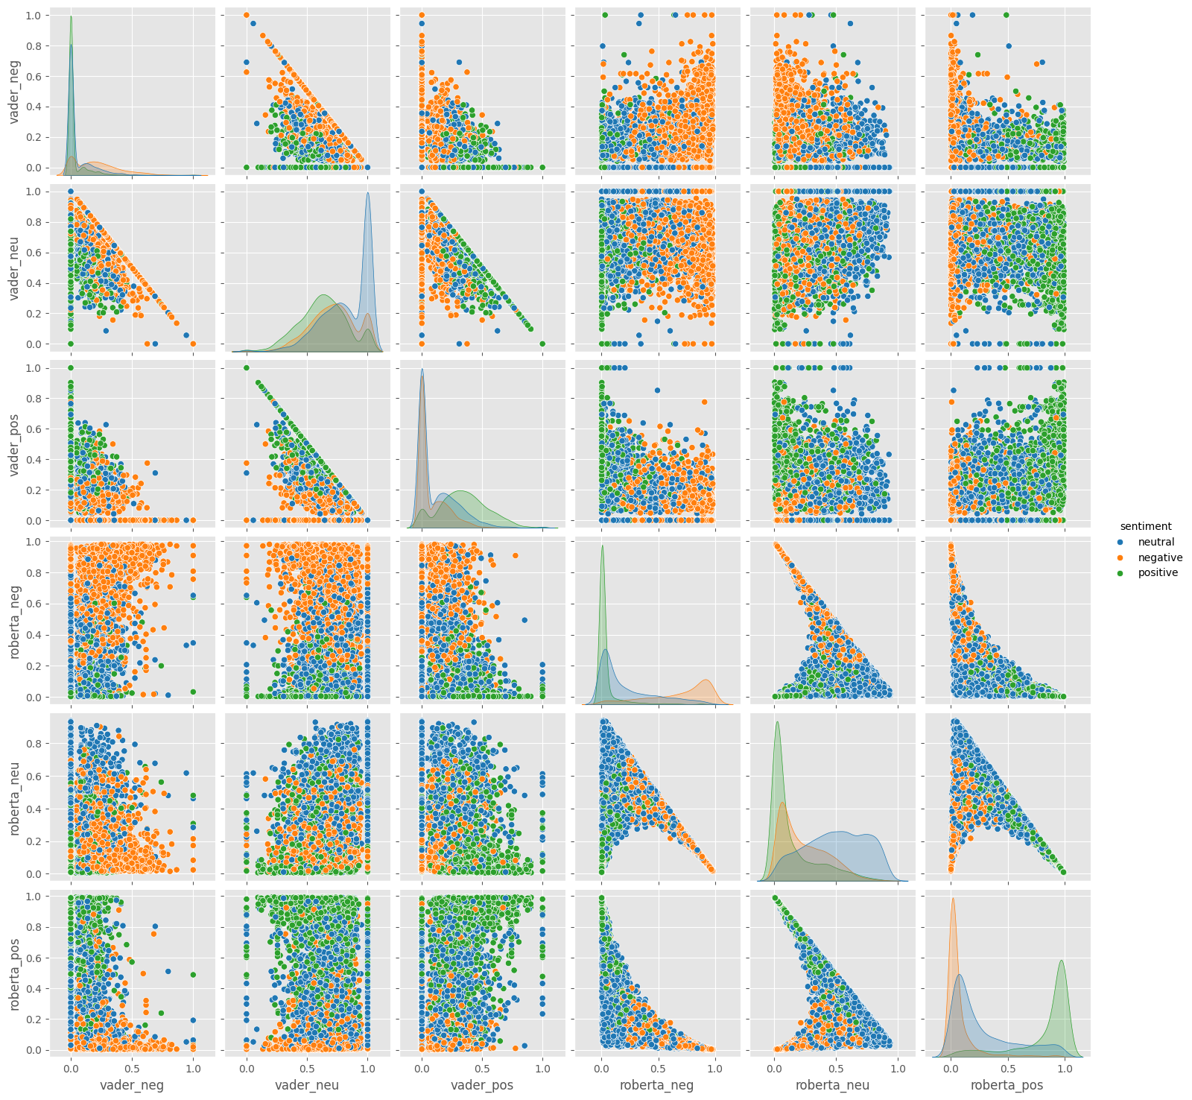
Results: 10. Comparison Between Results Of Vader And Roberta

Slide 22
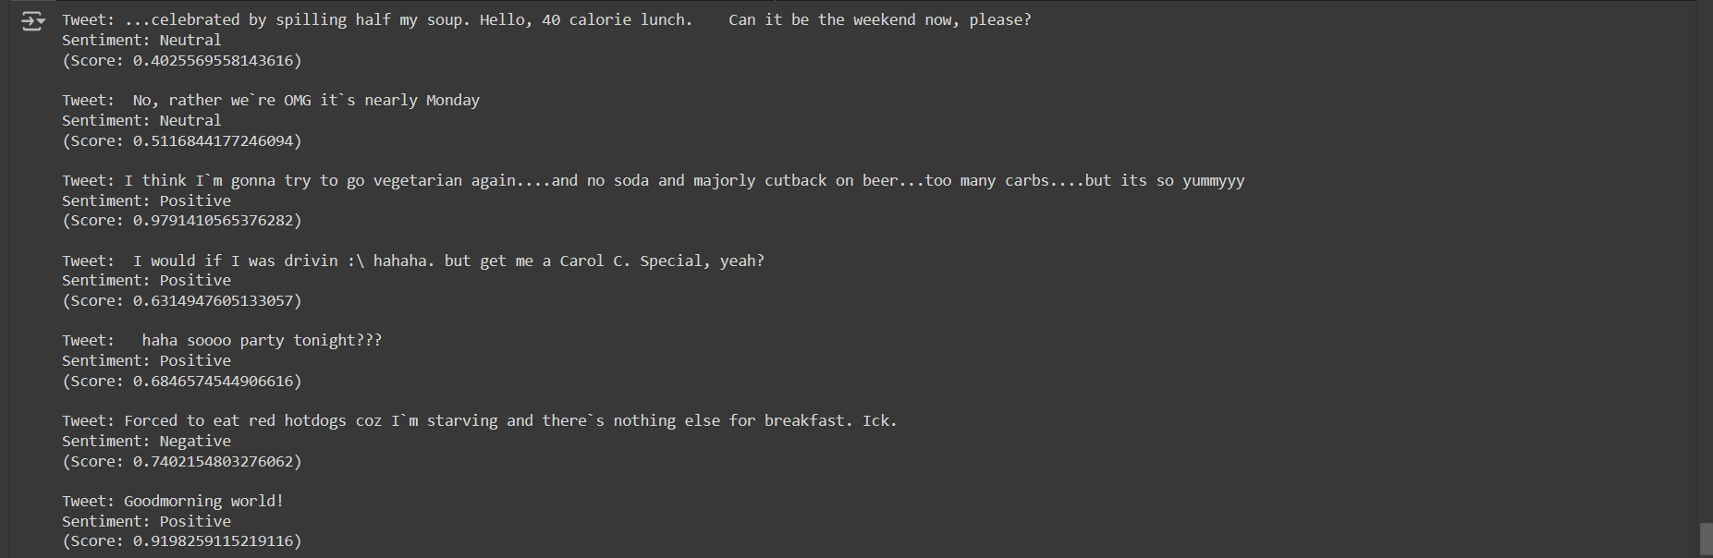
Results: 10. Final Result Of Roberta Model Using Twitter API

Slide 23
Applications
Trend Analysis: Researchers and analysts can analyze social media sentiment to identify emerging trends, track shifts in public opinion, and gain insights into societal dynamics.
Market Research: Market researchers can analyze social media sentiment to understand consumer preferences, track market trends, and inform product development strategies.
Customer Feedback Analysis: Companies can use sentiment analysis to analyze customer feedback on social media platforms, enabling them to improve products/services and enhance customer satisfaction.
Reputation Management: Organizations can monitor social media sentiment to manage their online reputation, respond to negative sentiment promptly, and maintain a positive brand image.
Event Monitoring: Event organizers can analyze social media sentiment to measure audience engagement, gather feedback, and assess the success of events in real-time.
Political Analysis: Political analysts and policymakers can use sentiment analysis to gauge public opinion on political issues, track sentiment towards political candidates, and inform campaign strategies.

Slide 24
Future Scope
The future scope of our social media sentiment analysis project is promising, with several avenues for further development and application. Firstly, advancements in natural language processing (NLP) and machine learning techniques offer opportunities to enhance the accuracy and efficiency of sentiment analysis algorithms, enabling a more nuanced understanding of textual data and context. Additionally, integrating multimodal data sources, such as images and videos, could provide richer insights into social media sentiment and user behavior. Furthermore, extending the scope of analysis beyond popular social media platforms to include emerging platforms and regional languages would enable a more comprehensive understanding of global sentiment trends. Collaborations with diverse stakeholders, including businesses, government agencies, and non-profit organizations, could lead to innovative applications in areas such as public health, crisis management, and social impact assessment. Overall, the future of our project lies in leveraging emerging technologies and interdisciplinary collaborations to address evolving challenges and opportunities in the realm of social media sentiment analysis.

Slide 25
Conclusion
We're using a powerful combination of Twitter’s API and the Roberta language model to analyze real-time Twitter sentiment. Tweepy acts like a bridge, fetching tweets from the live stream. Roberta, a sophisticated AI model, then examines these tweets and classifies them as positive, negative, or neutral. This ongoing analysis provides valuable insights into the overall mood of Twitter, giving us a real-time pulse of public opinion.

Slide 26
Reference
ChatGPT, chat.openai.com, Accesed on May 14,2024
Google, https://www.google.com, Accesed on February 25,2024

Slide 27
Thank You!!

